Slide 1

CSC3100 Data Structures Lecture 17: Graph shortest path
Yixiang Fang
School of Data Science (SDS)
The Chinese University of Hong Kong, Shenzhen

Slide 2
Outline
Single-Source Shortest Path Algorithm
Non-negative weights: Dijkstra’s algorithm
Non-negative and negative weights: Bellman-Ford algorithm
All-Pair Shortest Path Algorithm
Floyd’s algorithm

Slide 3
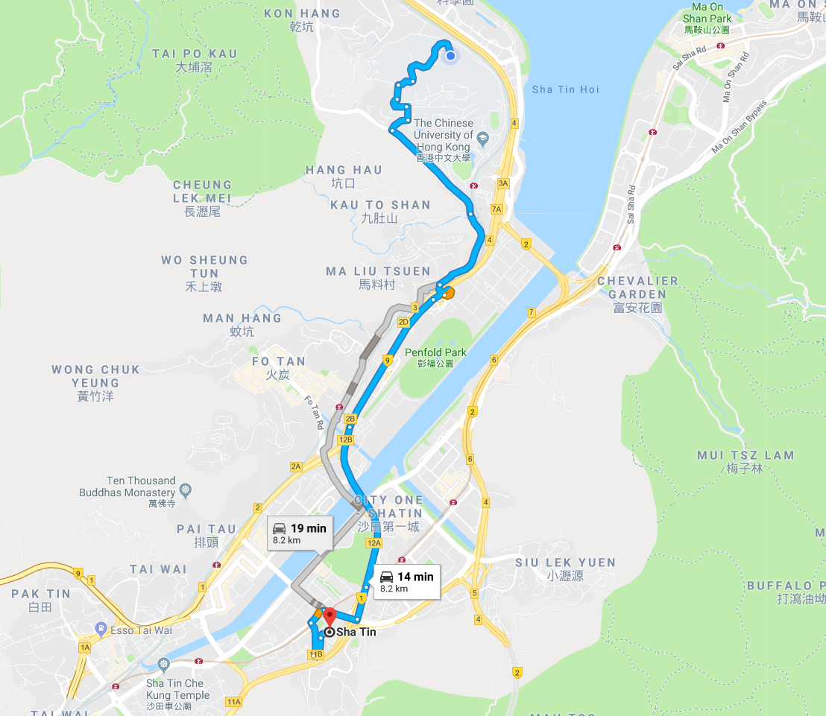
Weighted Graphs
In real world graphs, each edge may include additional information
For instance, on road networks, each edge (representing a road segment) can have a weight
The weight may be the distance between two road junction or the travel time from one junction to another
In navigation systems, e.g., Google Map, we may want to find the path with minimum travel time from the starting point to the ending point

Slide 4
Shortest Path Problems
How can we find the shortest route between two points on a road map?
Model the problem as a graph problem:
Road map is a weighted graph:
vertices = cities
edges = road segments between cities
edge weights = road distances
Goal: find a shortest path between two vertices (cities)

Slide 5









An example weighted graph
A weighted graph is a graph such that each edge $e$ is associated with a weight $w\left(e\right)$
We focus on directed graphs
The solution can be easily extended to undirected graphs
$$v_{2}$$
6
4
10
4
$$v_{6}$$
2
$$v_{4}$$
$w\left(v_{1},v_{2}\right)=4$
$w\left(v_{1},v_{3}\right)=7$
$⋯$
$$v_{1}$$
1
3
3
7
6
$$v_{7}$$
$$v_{3}$$
$$v_{5}$$
7
4

Slide 6
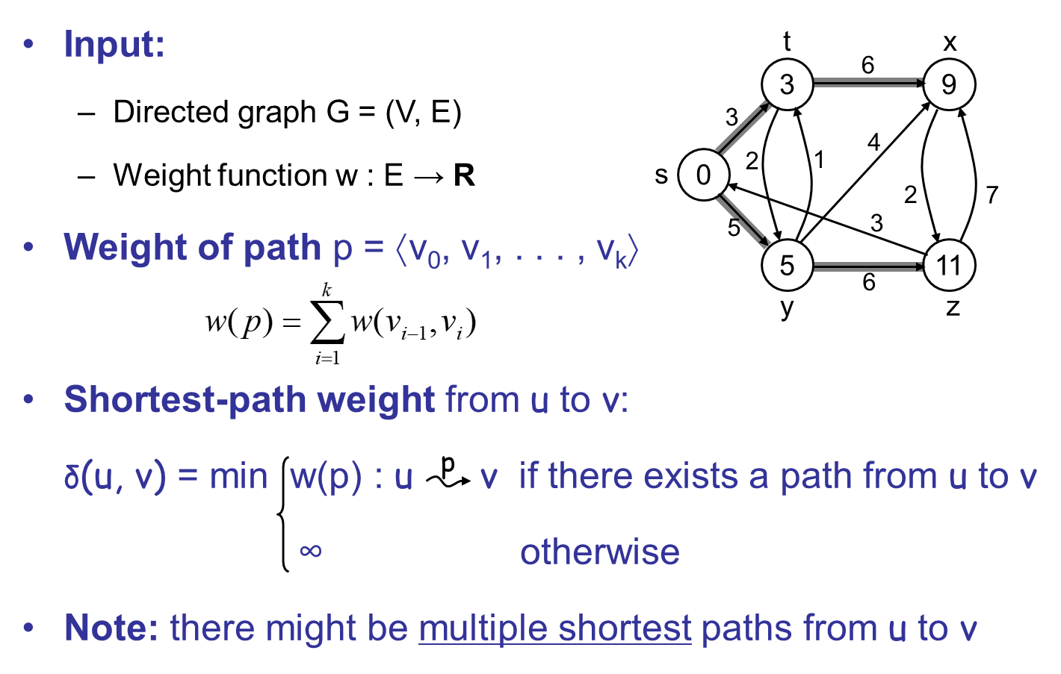
Shortest Path Problems
Notes:
Directed is a more general graph.
Undirected can be converted into the directed graph. Basically, the algorithm for directed graph also works for undirected graph.

Slide 7
Variants of Shortest Path
Single-source shortest paths
G = (V, E) ⇒ find a shortest path from a given source vertex s to each vertex v ∈ V
Single-destination shortest paths
Find a shortest path to a given destination vertex t from each vertex v
Reversing the direction of each edge ⇒ single-source
Single-pair shortest path
Find a shortest path from u to v for given vertices u and v
All-pairs shortest-paths
Find a shortest path from u to v for every pair of vertices u and v

Slide 8
Negative-Weight Edges
Negative-weight edges may form negative-weight cycles
If such cycles are reachable from
the source, then δ(s, v) is not properly defined!
Keep going around the cycle, and get
w(s, v) = - ∞ for all v on the cycle
a
b
-4
3
4
c
6
d
g
s
0
5
8
y
-3
2
3
7
e
-6
f
Notes:
e-f negative weight cycle
Chemistry: The weights can be used to represent the heat produced during a chemical reaction. (Modes: compounds, edge euveuv: if compound vv can be obtained ("chemically reduced") from uu. In this graph: you produce 44 kJ to convert s−as−a and 22 kJ to convert aa to tt. You need 55 kJ to get back ss from tt.
One Way to achieve some profit and then other way pay some costs

Slide 9
Cycles
Can shortest paths contain cycles?
Negative-weight cycles
Shortest path is not well defined
Positive-weight cycles:
By removing the cycle, we can get a shorter path
No!
No!

Slide 10
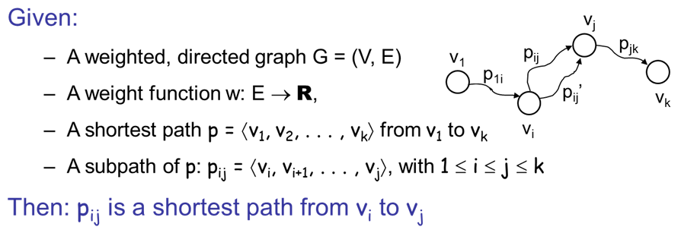
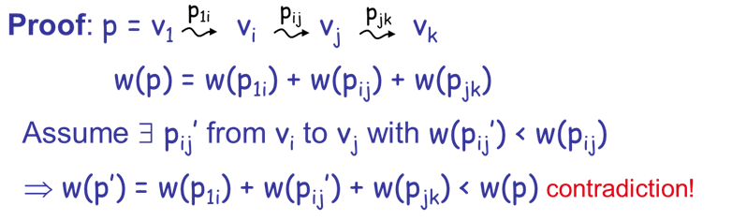
Optimal Substructure Theorem
Notes:
The subpath of the shortest path is also the shortest path between two nodes

Slide 11
Triangle Inequality
For all (u, v) ∈ E, we have:
δ (s, v) ≤ δ (s, u) + δ (u, v)
Proof?
If u is on the shortest path to v we have the equality sign
s
u
v
s
u
v
Notes:
How to prove? S->u->v is a path. Therefore the weight sum >= the shortest path

Slide 12
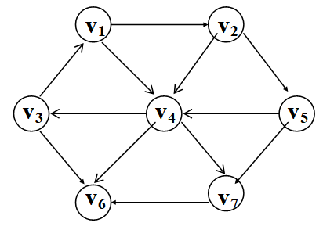
Shortest path algorithm
Unweighted Shortest Paths for Single-Source Graphs
A simple algorithm
1. Mark the starting vertex, s
2. Find and mark all unmarked vertices adjacent to s (vertices adjacent to s)
3. Find and mark all unmarked vertices adjacent to the marked vertices
4. Repeat Step 3 until no more vertices can be marked
Notes:
Design an algorithm to do this. Give an example. How many edges to reach the destination.

Slide 13
Shortest path algorithm
The strategy is known as breadth-first search
For each vertex, it is required to keep track of
whether the adjacent vertex has been marked (known)
its distance from s (d_{v})
previous vertex of the path from s (p_{v})
Notes:
If not using an queue, it will be the ||V||2. Cont

Slide 14
Shortest path algorithm
/* Pseudocode for better unweighted shortest-path algorithm with O(|E| + |V|) running time*/
void unweighted(Vertex s) {
Queue<Vertex> q = new Queue<Vertex>();
for each vertex { v.dist = INFINITY;}
s.dist = 0;
q.enqueue(s);
while(!q.isEmpty()){
Vertex v = q.dequeue();
for each Vertex w adjacent to v
if(w.dist == INFINITY){
w.dist = v.dist + 1;
w.path = v;
q.enqueue(w);
}
}
}
}
Running time is O(|E| + |V|)

Slide 15
Shortest path algorithm
Start vertex

Slide 16
Shortest path algorithm
Notes:
All nodes enter the queue as the same time has the same distance from the source. The later ones has one higher distance

Slide 17
Shortest path algorithm

Slide 18
Shortest path algorithm
Dijkstra’s Algorithm for single-source weighted graphs
A greedy algorithm, solving a problem by stages by doing what appears to be the best thing at each stage
Select a vertex v, which has the smallest d_{v} among all the unknown vertices, and declare that the shortest path from s to v is known
For each adjacent vertex, w, update d_{w} = d_{v} + c_{v,w} if this new value for d_{w} is an improvement
Notes:
D ai k str
Previous c = 1
Second not a queue. All nodes enter the queue has the same distance from the source. Now we have a cost. Then we need to use priority queue.

Slide 19
An Example of Using Dijkstra’s Algorithm
Given the graph, find shortest path starting from V₁:

Slide 20
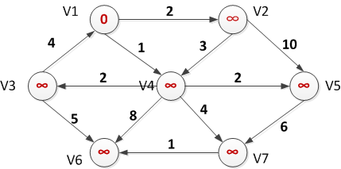
Intermediate Results of Dijkstra’s Algorithm
Initial Configuration
where v₁ is the start vertex

Slide 21
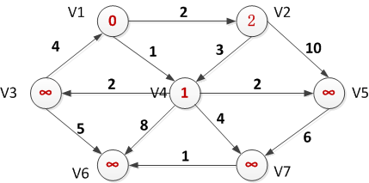
Intermediate Results of Dijkstra’s Algorithm (Cont’d)
After v₁ is declared known
Notes:
Each step update all adjacent nodes

Slide 22
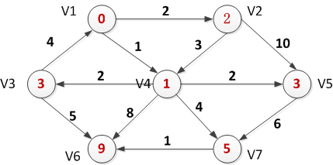
Intermediate Results of Dijkstra’s Algorithm (Cont’d)
After v₄ is declared known
After v₂ is declared known

Slide 23
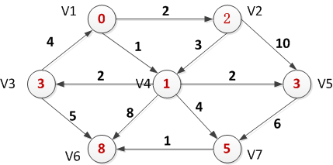


Intermediate Results of Dijkstra’s Algorithm (Cont’d)
After v₅ and then v₃ are declared known
After v₇ is declared known

Slide 24
Intermediate Results of Dijkstra’s Algorithm (Cont’d)
After v₆ is declared known

Slide 25
Initialization
Alg.: INITIALIZE-SINGLE-SOURCE(V, s)
for each v ∈ V
do d[v] ← ∞
p[v] ← NIL
d[s] ← 0
All the shortest-paths algorithms start with INITIALIZE-SINGLE-SOURCE

Slide 26
Relaxation Step
Relaxing an edge (u, v) = testing whether we can improve the shortest path to v found so far by going through u
If d[v] > d[u] + w(u, v)
we can improve the shortest path to v
⇒ d[v]=d[u]+w(u,v)
⇒ p[v] ← u
After relaxation:
d[v] = d[u] + w(u, v)
s
s
u
v
d[v]
u
v
5
2
9
5
2
6
d[u]
RELAX(u, v, w)
RELAX(u, v, w)
u
v
u
v
5
2
7
5
2
6
no change

Slide 27
Dijkstra (G, w, s)
INITIALIZE-SINGLE-SOURCE(V, s)
S ← ∅
Q ← V[G]
while Q ≠ ∅
do u ← EXTRACT-MIN(Q)
S ← S ∪ {u}
for each vertex v ∈ Adj[u]
do RELAX(u, v, w)
Update Q (DECREASE_KEY)
Running time: O(VlgV + ElgV) = O(ElgV)
Θ(V)
O(V) build min-heap
Executed O(V) times
O(lgV)
O(VlgV)
O(E) times
(total)
O(ElgV)
O(lgV)
Notes:
First extract s,
Relax all edges connecting S
Each edge is relaxed only once! Therefore it is O(ElgV)

Slide 28
Exercise
Show the steps of Dijkstra’s algorithm
t
1
x
∞
∞
10
9
s
0
2
3
4
6
5
7
∞
∞
2
y
z

Slide 29
Dijkstra (G, w, s)
S=<> Q=<s,t,x,z,y>
S=<s>
Q=<y,t,x,z>
t
1
x
t
x
∞
∞
1
∞
∞
10
10
9
10
9
s
0
2
3
4
6
2
3
4
6
s
0
5
7
7
5
∞
∞
∞
∞
2
5
2
y
z
y
z

Slide 30
Example (cont.)
t
1
x
t
1
x
10
∞
8
14
8
14
13
10
9
10
9
s
0
2
3
4
6
s
0
2
3
4
6
5
7
5
7
5
∞
5
7
7
2
2
y
z
y
z
S=<s,y> Q=<z,t,x>
S=<s,y,z> Q=<t,x>

Slide 31
Example (cont.)
S=<s,y,z,t> Q=<x>
S=<s,y,z,t,x> Q=<>
t
x
t
1
x
1
8
9
8
13
9
10
9
10
9
2
3
4
6
s
0
2
3
4
6
s
0
5
7
5
7
5
7
5
7
2
2
y
z
y
z

Slide 32
Correctness of Dijskstra’s Algorithm
For each vertex u ∈ V, we have d[u] = δ(s, u) at the time when u is added to S
Proof:
Let u be the first vertex for which d[u] ≠ δ(s, u) when added to S
Let’s look at a true shortest path p from s to u:

Slide 33
Correctness of Dijskstra’s Algorithm
0: Suppose the shortest to u is via u’
1. What is the value of d[u]?
d[u]≤d[v]+w(v,u)= δ(s,v)+w(v,u)
2. What is the value of d[u’]?
d[u’]≤d[v’]+w(v’,u’)= δ(s,v’)+w(v’,u’)
3. Since u’ is in the shortest path of u: d[u’]<δ(s,u)
d[u’]<d[u]
4. however, from definition: d[u]>=δ(s,u)
5. Contradiction!
Priority Queue Q: <u, …, u’, ….> (i.e., d[u]<…<d[u’]<… )
Notes:
What if u’u is negative. Assumption is every edge is positive. The minimum in the heap u, D[u] can’t be improved further.
Then we need another algorithm

Slide 34
Exercise 1
We are given a directed graph G=(V,E) on which each edge (u,v) has an associated value r(u,v), which is a real number in the range 0≤r(u,v) ≤1 that represents the reliability of a communication channel from vertex u to vertex v
We interpret r(u,v) as the probability that the channel from u to v will not fail, and we assume that these probabilities are independent
Give an efficient algorithm to find the most reliable path between two given vertices

Slide 35
Exercise 1
Solution 1: modify Dijkstra’s algorithm
r(u,v)=Pr(channel from u to v will not fail)
Assuming that the probabilities are independent, the reliability of a path p=<v₁,v₂,…,v_{k}> is:
r(v₁,v₂)r(v₂,v₃) … r(v_{k-1},v_{k})
We want to find the channel with the highest reliability, i.e.,

Slide 36
Exercise 1 (cont.)
But Dijkstra’s algorithm computes
Perform relaxation as follows:
if d[v] < d[u] w(u,v) then
d[v] = d[u] w(u,v)
Use “EXTRACT_MAX” instead of “EXTRACT_MIN”

Slide 37
Exercise 1 (cont.)
Solution 2: use Dijkstra’s algorithm without any modifications!
Goal
Take the lg

Slide 38
Exercise 1 (cont.)
Turn this into a minimization problem by taking the negative:
Run Dijkstra’s algorithm using

Slide 39
Exercise
Why Dijkstra’s algorithm cannot handle a graph that has negative weights but no negative cycles?
v
3
u
-2
2
u

Slide 40
Recommended Reading
Reading materials
Textbook Chapters 24&25
Next lecture
Shortest paths in graphs with negative weights
All pairs shortest path

